Slide 1
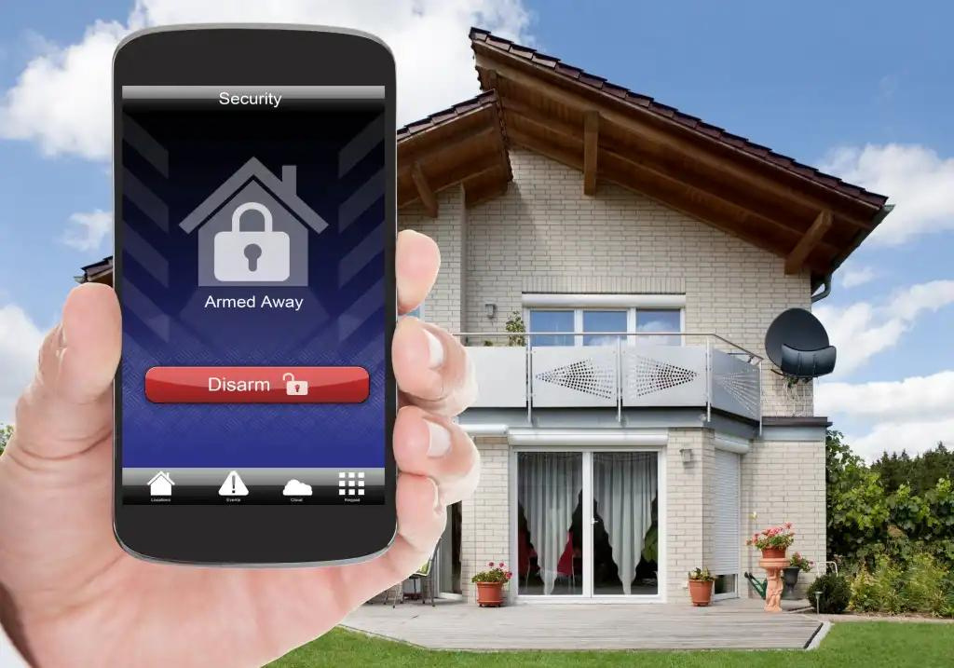


2023-054
SMART HOME ENVIRONMENT MONITORING AND INTELLIGENT ANTI-THEFT ALARMING SYSTEM

Slide 2
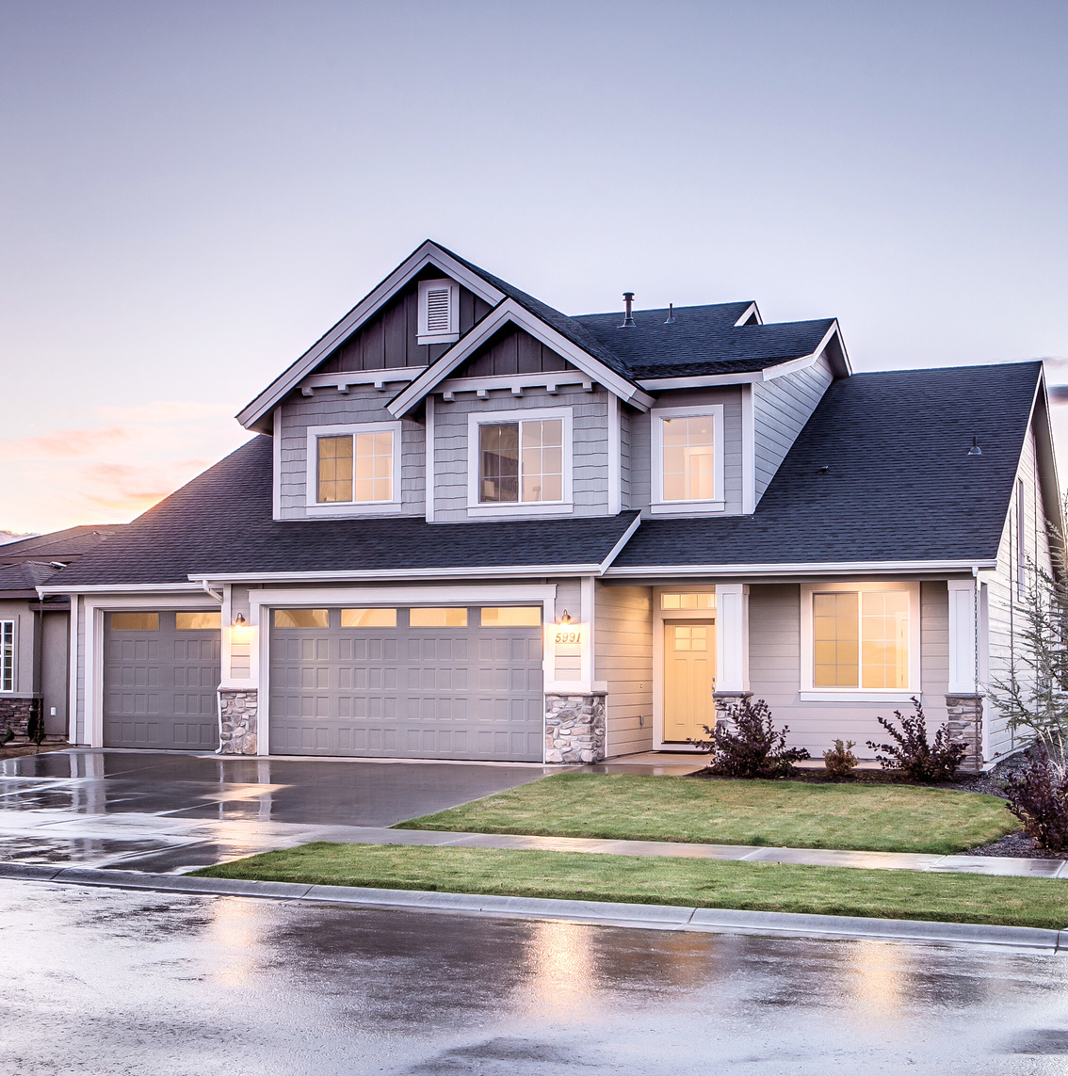


OVERVIEW
Introduction
Objectives
Overall Design Diagram
Background
Research Gap
Main and Sub Objectives
Research Questions
Methodology
Functional & Non-functional Requirements
Technologies to be Used
Work Breakdown Structure
Project Progress Completion
References
Commercialization
Q & A

Slide 3


SUPERVISOR PANEL
SUPERVISOR
Mrs. Narmada Gamage
C0-SUPERVISOR
Mrs. Malmaleesha Poojani Gunathilaka

Slide 4




MEET THE TEAM
Leader
Sunil Gunasinghage R.W
SuniM.M.S. Silva
J.S.P.A Ekanayake
Kodikara R.K.
IT20212704
CSNE
IT20383770
CSNE
IT20185534
CSNE
IT20182182
CSNE

Slide 5


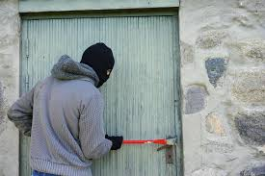
INTRODUCTION

Slide 6

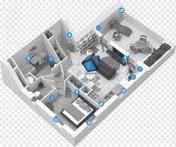
INTRODUCTION
Home security has become a major factor to be considered due to the rising rates of theft and burglary in modern society.
The Smart Home concept is the most recent solution invented to resolve such security problems in modern homes.
Anomaly detection is also a key concept in smart home systems where, unusual events are detected, and homeowners are alerted of these events

Slide 7

INTRODUCTION CONT.
Typical security systems for modern homes are built on static rules and thresholds that can be easily gotten around by knowledgeable burglars.
Also, the application of such measures may result in erroneous alarms, which could be annoying for homeowners.
To better protect against threats and reduce false alarms, smart home concept needs to take a much more sophisticated and adaptive approach.

Slide 8

SOLUTION
This cyber threat free ML powered system will monitor the behaviors & Voice patterns of the visitors as well as the Environment
To overcome these difficulties, Anomaly detection can be introduced.
Unusual events, such as strange sounds or movements, and deviations from what is expected can be detected using anomaly detection.
SMART HOME ENVIRONMENT MONITORING AND INTELLIGENT ANTI-THEFT ALARMING SYSTEM

Slide 9
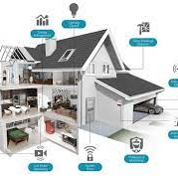
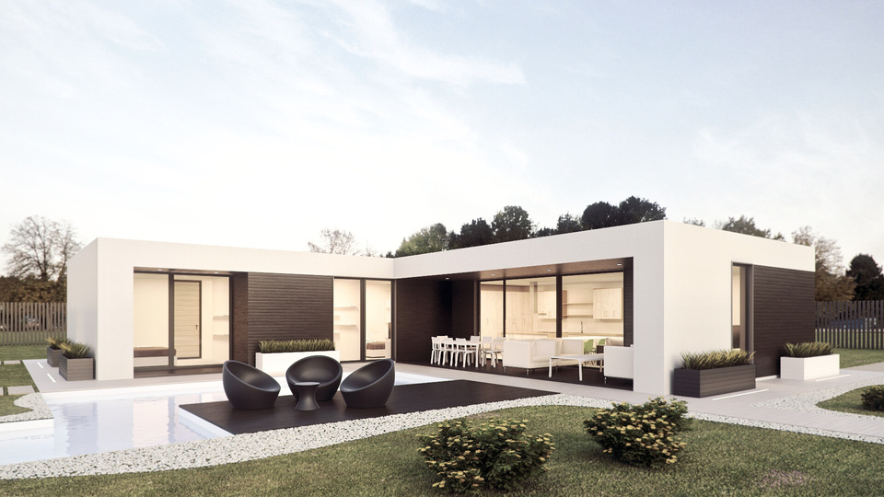
OBJECTIVES
MAIN OBJECTIVE
Create a cyber-threat free fully functioning smart home monitoring and an anti-theft system with enhanced physical security through behavior pattern and voice pattern monitoring and energy saving and protective plug bases.

Slide 10
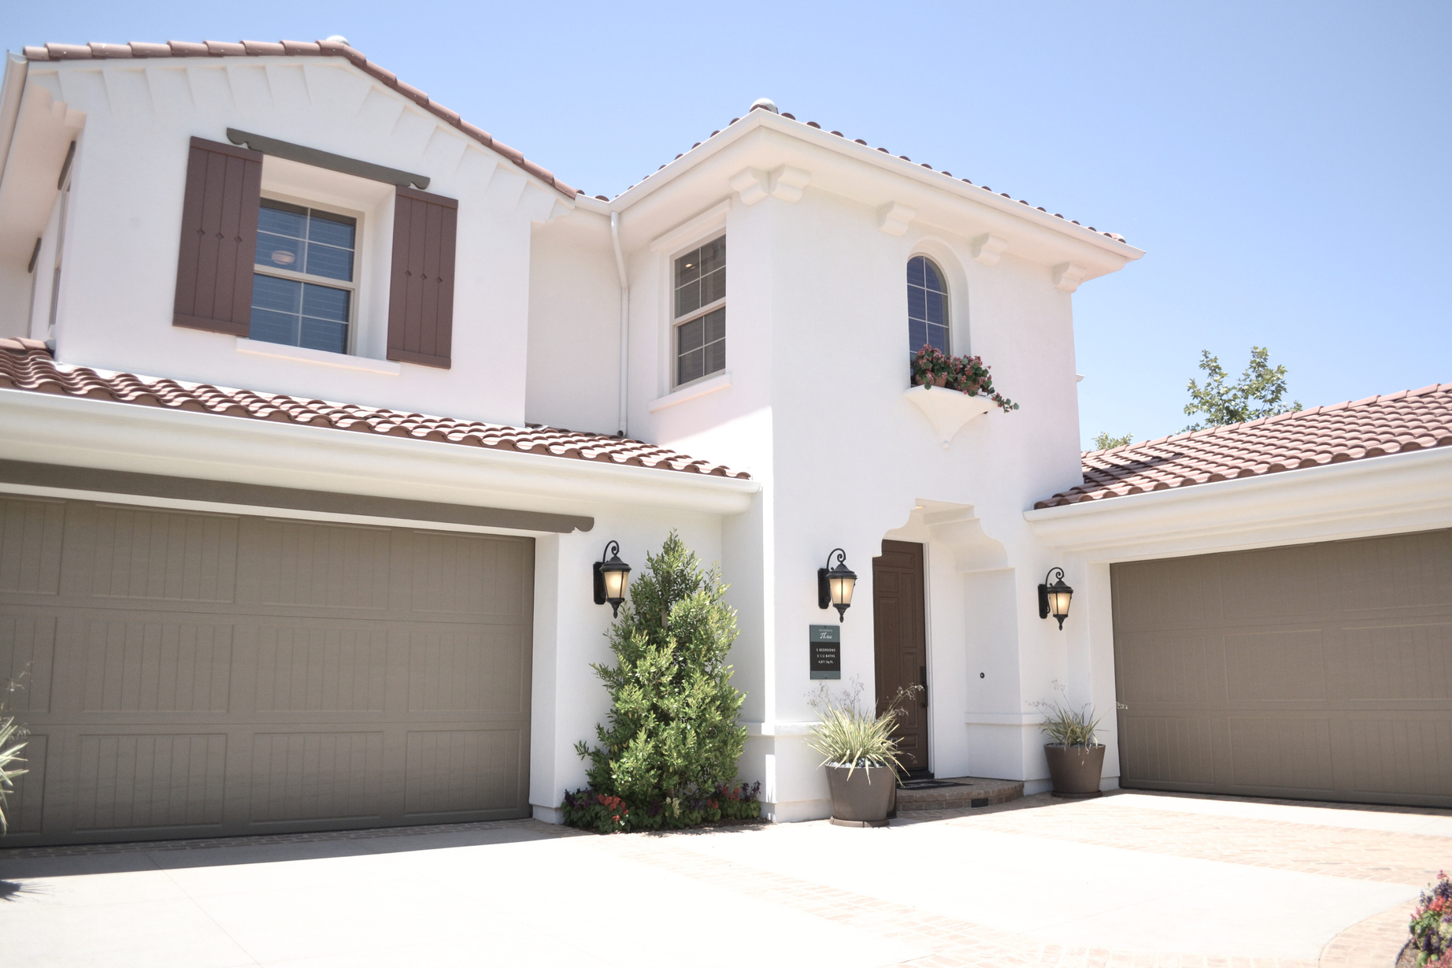
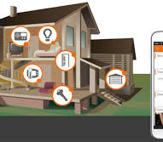
SUB OBJECTIVES
Enhance the physical security in a modern house by preventing intruder access.
Enhance the physical security in a modern house through anomaly(abnormal) voice detection.
Enable secure data communication in a modern house to enhance physical safety.
Enable an electric hazard-free environment in a modern house.

Slide 11
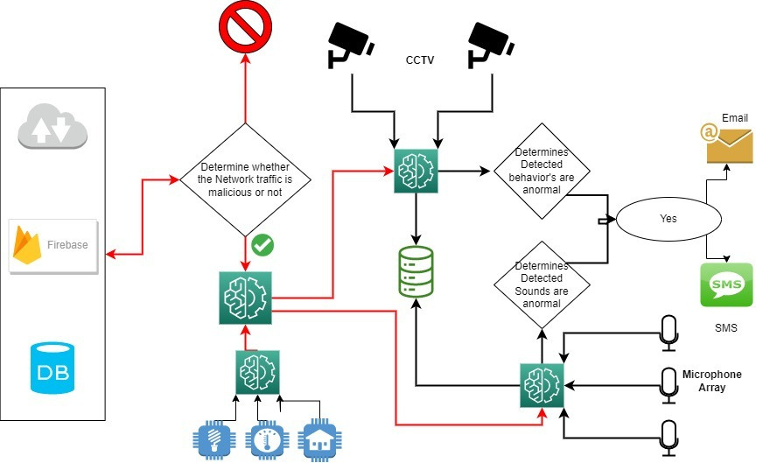
OVERALL DESIGN DIAGRAM

Slide 12
ENHANCE THE PHYSICAL SECURITY IN A MODERN HOUSE BY PREVENTING INTRUDER ACCESS.
Leader
Sunil Gunasinghage R.W
IT20212704
CSNE

Slide 13
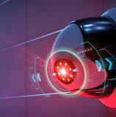
BACKGROUND
Household security and safety are increasingly important issues in the contemporary world.
The proliferation of high-tech security systems and smart homes has given people new options for keeping their homes secure.
The goal of my suggested project component is to develop an intrusion access prevention system for contemporary dwellings that is powered by machine learning.
Sunil Gunasinghage IT20212704 CSNE

Slide 14
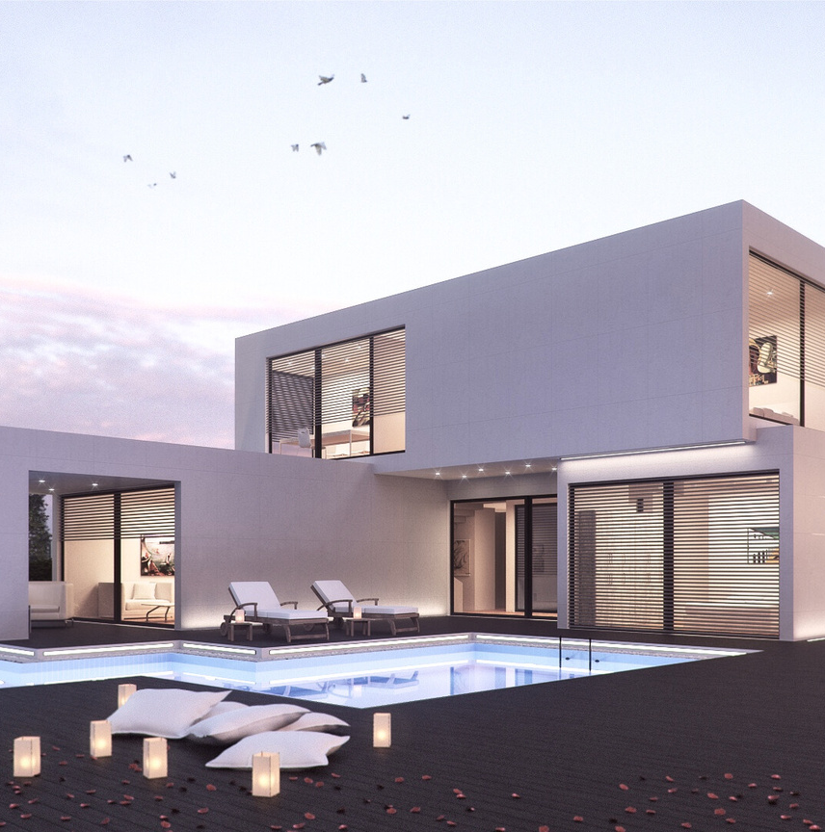
BACKGROUND CONT.
Household security and safety are increasingly important issues in the contemporary world.
The proliferation of high-tech security systems and smart homes has given people new options for keeping their homes secure.
The goal of my suggested project component is to develop an intrusion access prevention system for contemporary dwellings that is powered by machine learning.
Sunil Gunasinghage IT20212704 CSNE

Slide 15
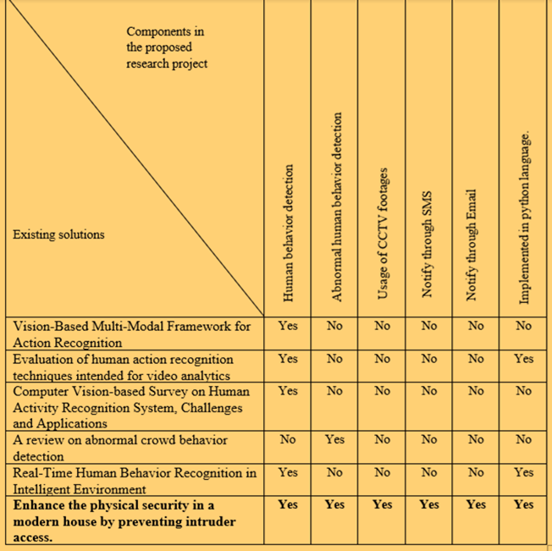
RESEARCH GAP
Sunil Gunasinghage IT20212704 CSNE

Slide 16
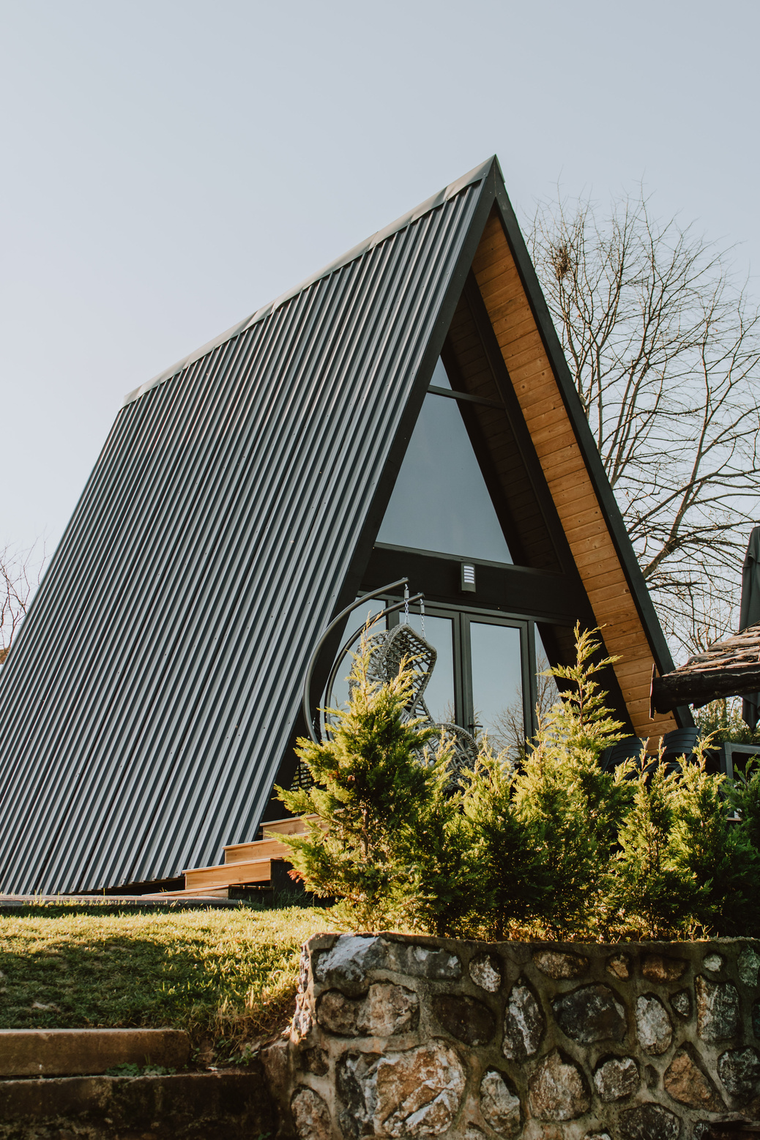
MAIN OBJECTIVE
The main objective of this research is to enhance the physical security in a modern house by preventing intruder access.
Sunil Gunasinghage IT20212704 CSNE

Slide 17
SUB OBJECTIVES
The ML-powered intruder access prevention system has been proposed to develop in the following specific sub-objectives mentioned below.
Create a system that accurately identifies the behavior of the guest.
Create a system that accurately understands the behavior of the guest.
Establishment of email and SMS services in notifying procedures.
Integrate the intruder access prevention system with the established email and SMS services.
Sunil Gunasinghage IT20212704 CSNE

Slide 18
RESEARCH QUESTIONS
How to identify and understand the actions of the visitors?
How to implement SMS and email services?
How to integrate all technologies together?
Sunil Gunasinghage IT20212704 CSNE

Slide 19
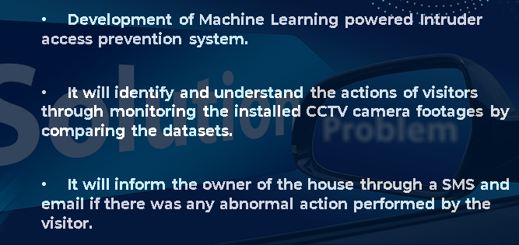
RESEARCH SOLUTION
Sunil Gunasinghage IT20212704 CSNE

Slide 20
METHODOLOGY
Conduct a literature review: Gather and analyze relevant research papers, reports, and case studies related to behavior monitoring and intruder access prevention mechanisms.
Collect data: Conduct data collection using the selected research methods.
Analyze data: Use appropriate data analysis techniques to process and interpret the collected data.
Sunil Gunasinghage IT20212704 CSNE

Slide 21
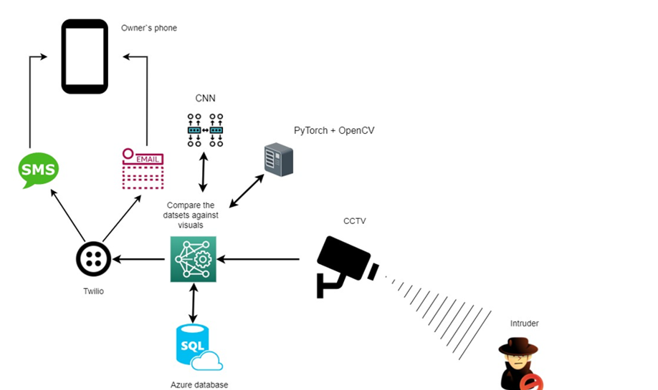
METHODOLOGY CONT.
Sunil Gunasinghage IT20212704 CSNE

Slide 22
FUNCTIONAL & NON-FUNCTIONAL REQUIREMENTS
FUNCTIONAL
Action Detection
Abnormal action Detection
Record the Abnormal Behavior Patterns
Provide Real-time Alerts
NON-FUNCTIONAL
Secure and Protect User Data
Reliable and Available
Sunil Gunasinghage IT20212704 CSNE

Slide 23
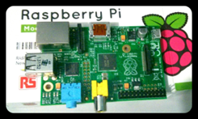
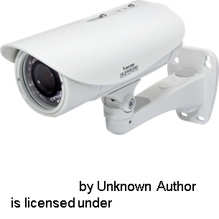




TECHNOLOGIES TO BE USED
SOFTWARE REQUIREMENTS
Programming Language - Python
Framework - PyTorch
Communication Library - Twilio
Cloud service for storing data - Microsoft Azure
HARDWARE REQUIREMENTS
Raspberry PI
CCTV cameras
Network Devices
Sunil Gunasinghage IT20212704 CSNE

Slide 24

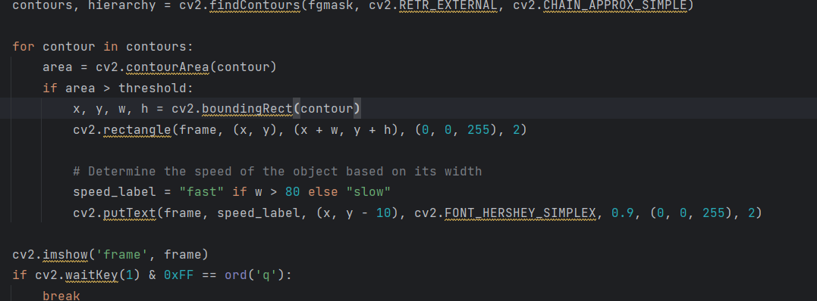
PROJECT PROGRESS
Developed the human action live detecting system.
Developed the frame analyzing algorithm for the above system.
Created a manual dataset for covered faces.
Sunil Gunasinghage IT20212704 CSNE

Slide 25
FUTURE PROGRESS
Integrate the covered face detecting part.
Develop the system to work real time with a camera.
Develop an interface to see the footages.
Sunil Gunasinghage IT20212704 CSNE

Slide 26
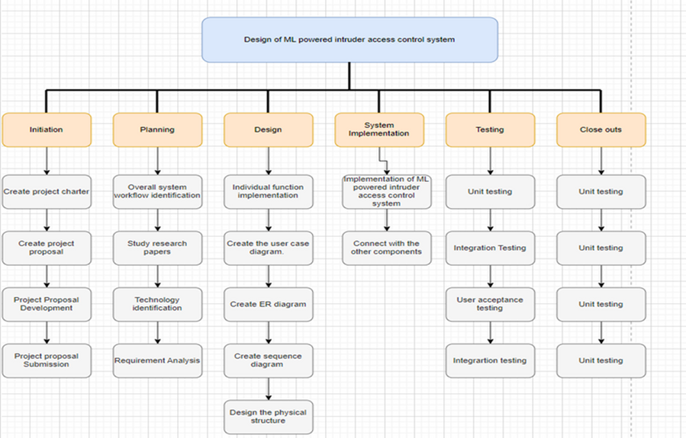
WORK BREAKDOWN STRUCTURE
Sunil Gunasinghage IT20212704 CSNE

Slide 27
REFERENCE
.[1] B. D. Romaissa, O. Mourad and N. Brahim, "Vision-Based Multi-Modal Framework for Action Recognition," 2020 25th International Conference on Pattern Recognition (ICPR), Milan, Italy, 2021, pp. 5859-5866, doi: 10.1109/ICPR48806.2021.9412863.
[2] S. R. Rashmi, S. Bhat, and V. C. Sushmitha, "Evaluation of human action recognition techniques intended for video analytics," 2017 International Conference On Smart Technologies For Smart Nation (SmartTechCon), Bengaluru, India, 2017, pp. 357-362, doi: 10.1109/SmartTechCon.2017.8358396.
[3] A. M. F and S. Singh, "Computer Vision-based Survey on Human Activity Recognition System, Challenges and Applications," 2021 3rd International Conference on Signal Processing and Communication (ICPSC), Coimbatore, India, 2021, pp. 110-114, doi: 10.1109/ICSPC51351.2021.9451736.
[4] K. Rohit, K. Mistree and J. Lavji, "A review on abnormal crowd behavior detection," 2017 International Conference on Innovations in Information, Embedded and Communication Systems (ICIIECS), Coimbatore, India, 2017, pp. 1-3, doi: 10.1109/ICIIECS.2017.8275999.
[5] Y. Yuan, Z. Miao, and S. Hu, "Real-Time Human Behavior Recognition in Intelligent Environment," 2006 8th International Conference on Signal Processing, Guilin, China, 2006, pp., doi 10.1109/ICOSP.2006.345793.
Sunil Gunasinghage IT20212704 CSNE

Slide 28
ENHANCE THE PHYSICAL SECURITY IN A MODERN HOUSE THROUGH ANOMALY VOICE DETECTION.
M.M.S. Silva
IT20383770
CSNE

Slide 29


BACKGROUND
Human communication almost 70% is based on speech.
The workload of the future world however depends on machines rather than manual work.
Even the most sophisticated anti-theft security systems include voice recognition technology, they have failed to incorporate advanced voice recognition functions in their security systems.
M.M.S. Silva IT20383770 CSNE

Slide 30


BACKGROUND CONT.
RESEARCH GAP
In fact, these systems are incapable of distinguishing between the owners of the concerned property and strangers or trespassers using voice/sound patterns.
Also, the current security systems are unable to identify whether these people pose a threat to the system or not.
So, there’s a demand for an advanced security system which have enhanced features to overcome the above challenges.
M.M.S. Silva IT20383770 CSNE

Slide 31
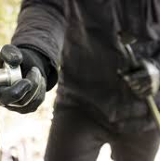
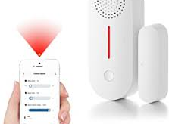
RESEARCH GAP
Lack of research on the effectiveness of anomaly voice detection in modern houses.
Limited research on the accuracy of anomaly voice detection systems.
Limited research on the integration of anomaly voice detection systems with other security measures.
Limited research on the effects of false positives and false negatives.
M.M.S. Silva IT20383770 CSNE

Slide 32
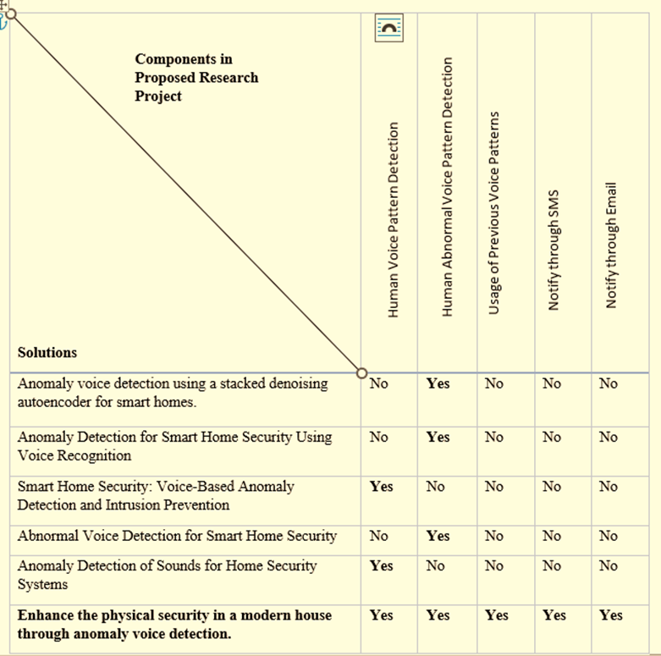

M.M.S. Silva IT20383770 CSNE

Slide 33

MAIN OBJECTIVE
SUB OBJECTIVES
Enhance the physical security in a modern house through anomaly (abnormal) voice detection.
M.M.S. Silva IT20383770 CSNE

Slide 34
SUB OBJECTIVES
To assess the accuracy and reliability of anomaly voice detection systems in identifying abnormal voices in various situations.
To evaluate the level of technical expertise needed to use the system and how simple it is to install and maintain, as well as the usability of anomaly voice detection systems for homeowners.
The overall goal of the research is to provide recommendations for the future development and application of the technology.
M.M.S. Silva IT20383770 CSNE

Slide 35

RESEARCH QUESTIONS
What is the state of physical security in modern homes and what are the limitations of traditional security measures?
What kinds of anomalies can be identified using technology for anomaly voice detection, and how does it operate?
What ethical and legal issues are raised by using anomaly sound detection technology in contemporary homes, and how can these issues be resolved?
How can anomaly sound detection technology be combined with other home security features like motion detectors and security cameras?
M.M.S. Silva IT20383770 CSNE

Slide 36

RESEARCH SOLUTION
Capture different types of voices and sounds using an array of microphones.
Compare the obtained voice-clips with the prerecorded ones in the data base of the security system.
Prompt feedback to the owner of the in case of an anomaly from the recorded data is detected.
With each sound captured, the database is updated accordingly.
M.M.S. Silva IT20383770 CSNE

Slide 37

METHODOLOGY
METHODOLOGY CONT.
The First Step - Comprehensive literature review
The Second Step - Data Collection(Utilizing information from recorded conversations, several anomalous voice types including violent or suspicious behavior, unlawful access)
The Third Step - The creation of a prototype sound detection system (The prototype will be evaluated and improved)
It was decided to use Python language to implement the logical part and this system will be implemented on a Raspberry Pi board
The Fourth Step - The creation of protocols and instructions
The Fifth Step - Field testing
M.M.S. Silva IT20383770 CSNE

Slide 38
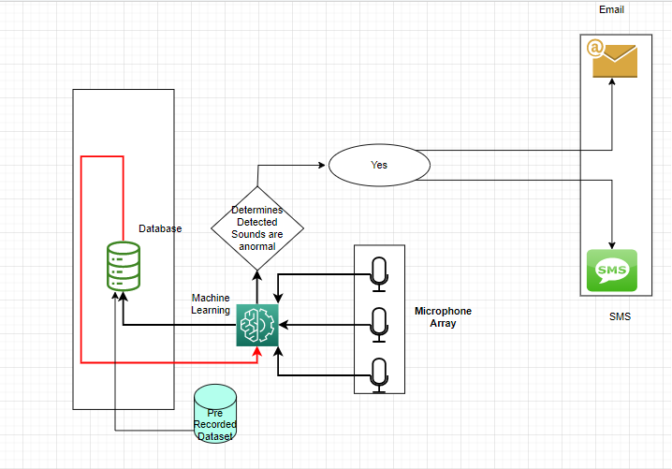
METHODOLOGY CONT.
M.M.S. Silva IT20383770 CSNE

Slide 39
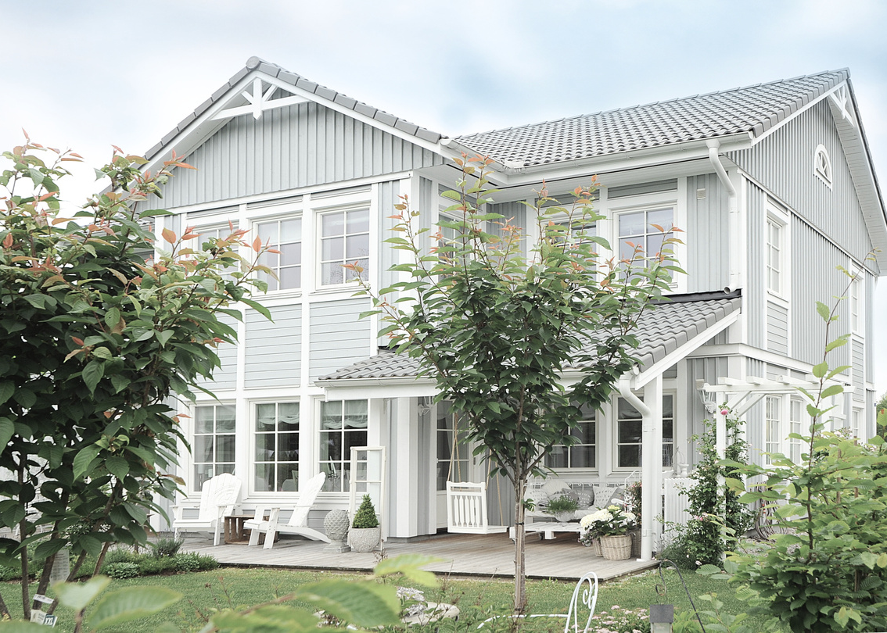
FUNCTIONAL & NON-FUNCTIONAL REQUIREMENTS
FUNCTIONAL
NON-FUNCTIONAL
Voice Detection
Anomaly Voice Detection
Record the Abnormal Voice Patterns
Computing Degree of Threat
Provide Real-time Alerts
Secure and Protect User Data
Reliable and Available
Scalable and Adaptable
M.M.S. Silva IT20383770 CSNE

Slide 40
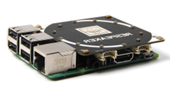
TECHNOLOGIES TO BE USED
SOFTWARE REQUIREMENTS
Programming Language - Python
Framework - PyTorch
Communication Library - Twilio
Cloud service for storing data - Microsoft Azure
HARDWARE REQUIREMENTS
Raspberry PI
Microphone Array
Network Devices
M.M.S. Silva IT20383770 CSNE

Slide 41
CURRENT PROJECT PROGRESS
50%
Preparing Relevant Datasets.(Normal and Abnormal Sounds)
Development of a Machine learning model
Training the model using prepared dataset
M.M.S. Silva IT20383770 CSNE

Slide 42
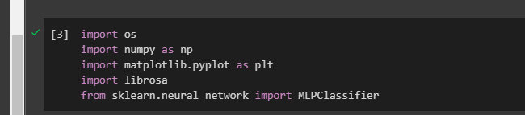
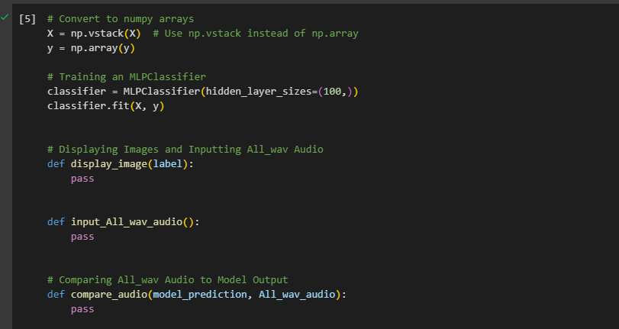
PROJECT COMPLETE SO FAR
M.M.S. Silva IT20383770 CSNE

Slide 43
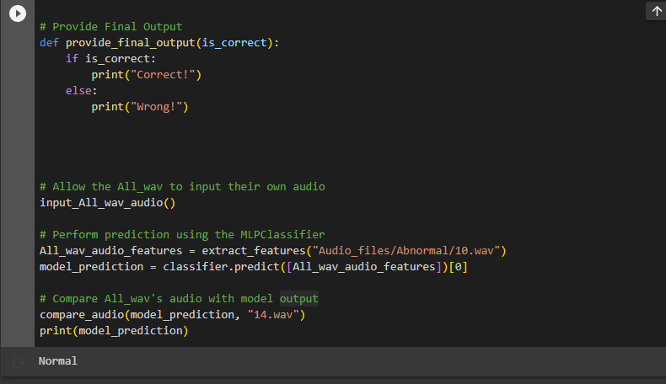
PROJECT COMPLETE SO FAR
M.M.S. Silva IT20383770 CSNE

Slide 44
FUTURE PROGRESS
Next step is to record Sound Clips from Microphone array and send it to the ML Model.
Also have to Improve ML Model For Better Accuracy.
Also have to Implement Time setting for Start and Stop
M.M.S. Silva IT20383770 CSNE

Slide 45
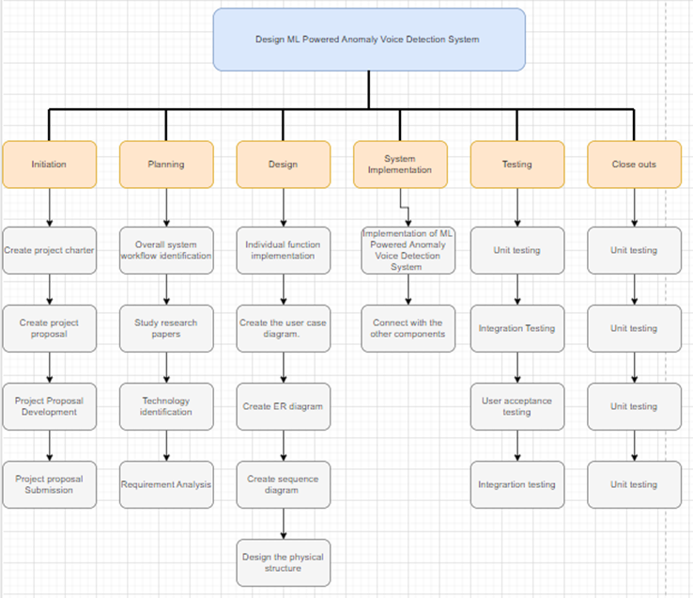
WORK BREAKDOWN STRUCTURE
M.M.S. Silva IT20383770 CSNE

Slide 46
REFERENCE
[1]D. Kim, C. Hwang and T. Lee, "Stacked-autoencoder based anomaly detection with Industrial Control System," Software Engineering, Artificial Intelligence, Networking and Parallel/Distributed Computing, p. 191, 202
[2]Y. Sun, J. Yang and C.-H. Hsu, "Anomaly Detection for Smart Home Security Using Voice Recognition," IEEE Transactions on Industrial Informatics, vol. 15, no. 6, pp. 3218-3226, 2019
[3]A. Ghandeharioun and R. W. Picard, "Smart Home Security: Voice-Based Anomaly Detection and Intrusion Prevention," IEEE Transactions on Multimedia, vol. 19, no. 4, pp. 807-819, 2017.
[4]Z. Yao, H. Yao and X. Zhang, "Abnormal Voice Detection for Smart Home Security," IEEE Transactions on Multimedia, vol. 21, no. 4, pp. 973-985, 2019.
[5]I. R. Parameshwaran and R. Prakash, "Anomaly Detection of Sounds for Home Security Systems," IEEE Sensors Journal, vol. 18, no. 22, pp. 9233-9242, 2018.
[6]V. Priya, R. V. and . K. V. , "Secure Smart Home System Using Anomaly Detection," 2020 International Conference on Communication and Signal Processing (ICCSP), pp. 0893-0898, 2020.
[7]A. S. Adhav and S. G. Kulkarni, "Smart Home Security System Using Anomaly Detection with Deep Learning," 2021 International Conference on Data Science and Communication (IconDSC), Pune, India, pp. 1-6, 2021.
M.M.S. Silva IT20383770 CSNE

Slide 47
ENABLE SECURE DATA COMMUNICATION IN A MODERN HOUSE TO ENHANCE THE PHYSICAL SAFETY.
J.S.P.A Ekanayake
IT20108922
CSNE

Slide 48
BACKGROUND
IoT devices are often designed with limited security measures, making them easy targets for cyber criminals. Additionally, the sheer volume and diversity of IoT devices makes it difficult to implement standard security protocols across all devices. As a result, IoT systems are increasingly vulnerable to a variety of cyber-attacks, including malware infections, denial-of-service attacks, and data theft.
J.S.P.A Ekanayake IT20108922 CSNE

Slide 49
RESEARCH GAP
BACKGROUND CONT.
THIS SYSTEM ENHANCES THE PHYSICAL SECURITY OF A HOUSE, BUT WHAT HAPPENS IF SABOTAGED IT BY USING A CYBER-ATTACK?
This research focuses on how to secure IoT devices in smart homes, specifically home monitoring and anti-theft systems. The discussion will revolve around the use of these technologies to detect and prevent intrusions and potential security breaches, enhancing the safety and privacy of homeowners.
J.S.P.A Ekanayake IT20108922 CSNE

Slide 50
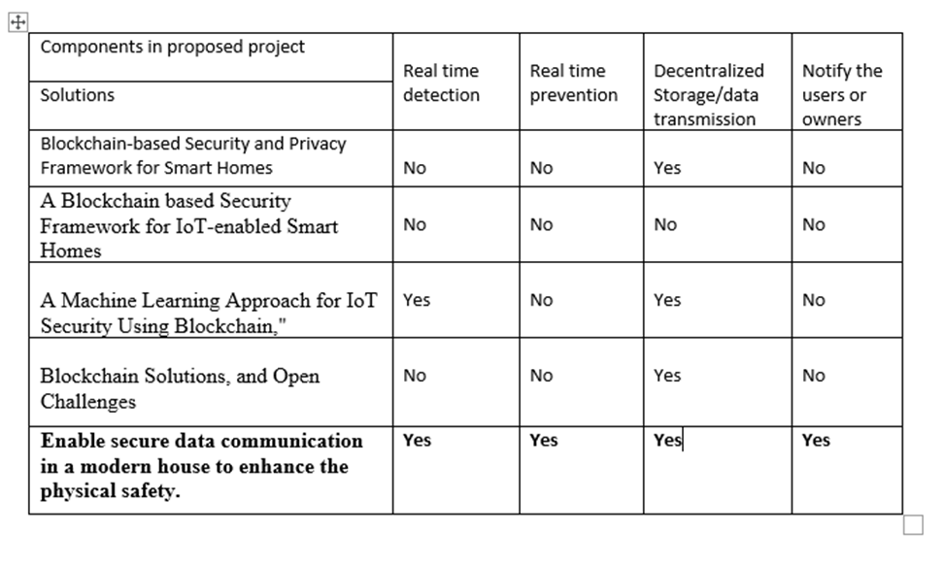
RESEARCH GAP
J.S.P.A Ekanayake IT20108922 CSNE

Slide 51
SUB OBJECTIVES
MAIN OBJECTIVE
Enable secure data communication in a modern house to enhance the physical safety.
J.S.P.A Ekanayake IT20108922 CSNE

Slide 52
SUB OBJECTIVES
Conduct more research on adversarial attacks
Develop a Machine learning model to detect cyber threats by analyzing the network traffic and prevent cyber threats.
Develop a Blockchain based solution to store data securely and transmit data without getting theft.
J.S.P.A Ekanayake IT20108922 CSNE

Slide 53
RESEARCH QUESTIONS
How to detect threats and response in real-time?
How to address privacy concerns?
How to prevent data tempering and theft?
J.S.P.A Ekanayake IT20108922 CSNE

Slide 54
METHODOLOGY
Conduct a literature review: Gather and analyze relevant research papers, reports, and case studies related to IoT security. Identify best practices, frameworks, and standards for securing IoT systems from cyber threats.
Collect data: Conduct data collection using the selected research methods.
Analyze data: Use appropriate data analysis techniques to process and interpret the collected data. For example, use statistical analysis to identify patterns and trends in the data.
Develop a security solution: Based on the research findings, propose a security solution that addresses the identified vulnerabilities and meets the system requirements.
J.S.P.A Ekanayake IT20108922 CSNE

Slide 55
METHODOLOGY
Implement the security solution: Test and implement the proposed security solution in the IoT system
Evaluate the security solution: Conduct a post- implementation evaluation of the security solution to assess its effectiveness in mitigating cyber threats.
J.S.P.A Ekanayake IT20108922 CSNE

Slide 56
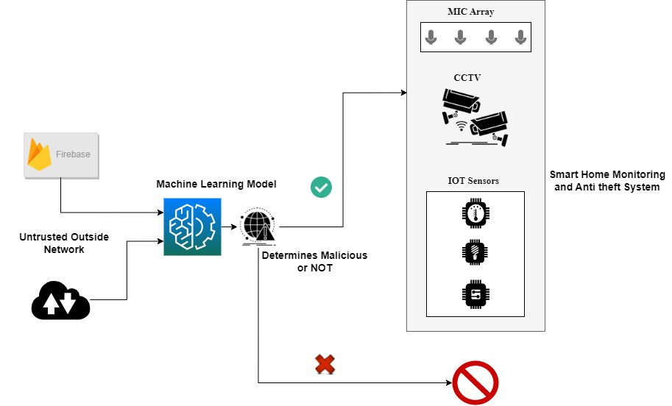
METHODOLOGY
J.S.P.A Ekanayake IT20108922 CSNE

Slide 57
FUNCTIONAL &
NON-FUNCTIONAL REQUIREMENTS
FUNCTIONAL
NON-FUNCTIONAL
Detecting the cyber attacks Realtime
Preventing the cyber-attacks Realtime
Preventing the modification and theft of data
Availability
Security
J.S.P.A Ekanayake IT20185534 CSNE

Slide 58


TECHNOLOGIES TO BE USED
Machine Learning
Random Forest
MLPClassifier
Python
Blockchain
J.S.P.A Ekanayake IT20185534 CSNE

Slide 59
CURRENT PROJECT PROGRESS
50%
Preparing Relevant Datasets.
Development of a Machine learning model
Training the model using prepared dataset
Ekanayake J.S.P.A IT20108922 CSNE

Slide 60
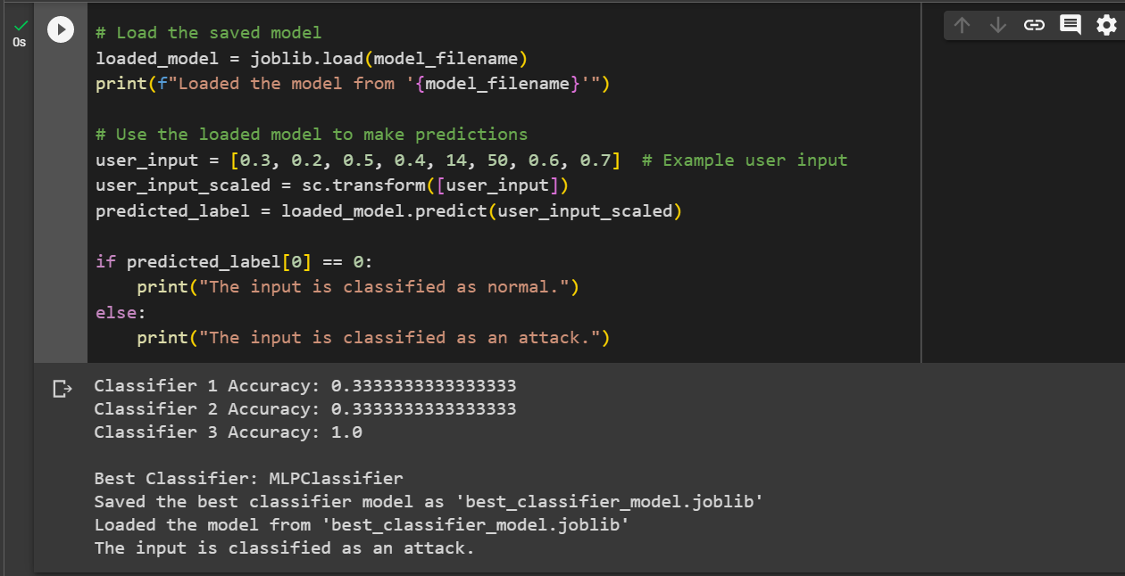
PROJECT COMPLETE SO FAR
Implemented a Successful machine learning model to detect cyber attacks succesfully.
Ekanayake J.S.P.A IT20108922 CSNE

Slide 61
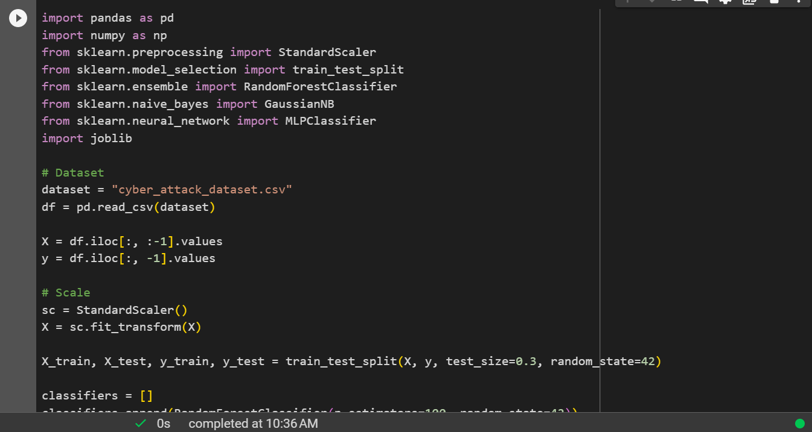
PROJECT COMPLETE SO FAR
Ekanayake J S P A IT20108922 CSNE

Slide 62
FUTURE PROGRESS
Enhance the Accuracy of Current Model.
Reducing the detection time.
Configure alerts to users.
Development of Network traffic capturing model.
Ekanayake J S P A IT20108922 CSNE

Slide 63
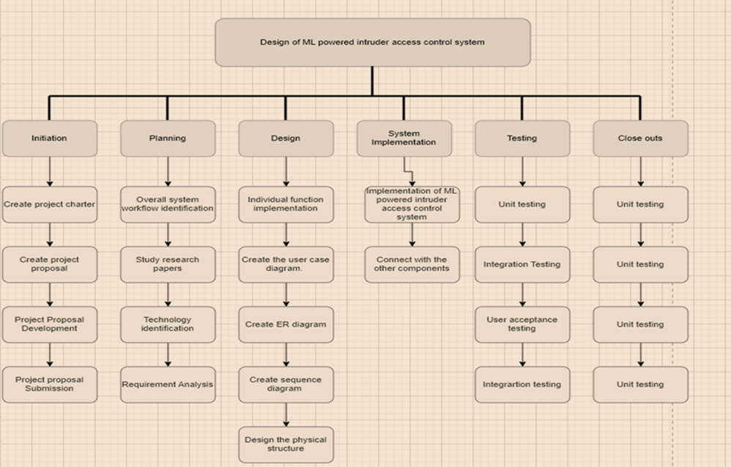
WORK BREAKDOWN STRUCTURE
J.S.P.A Ekanayake IT20185534 CSNE

Slide 64
REFERENCE
A Comprehensive Survey of IoT Security: Threats, Vulnerabilities, and Solutions" by S. Sicari et al.
"Securing the Internet of Things: A Survey on Current Challenges and Solutions" by M. Al-Fuqaha et al.
"Security and Privacy Challenges in the Internet of Things" by R. Roman et al.
"IoT Security: Review, Blockchain Solutions, and Open Challenges"
"Blockchain-based Security and Privacy Framework for Smart Homes" by S. K. Das et al.
J.S.P.A Ekanayake IT20185534 CSNE

Slide 65
ENABLE ELECTRIC HAZARD-FREE ENVIRONMENT IN A MODERN HOUSE.
Kodikara R.K.
IT20182182
CSNE

Slide 66
BACKGROUND
Providing a smart plug base to the home environment for security
Monitor the motions, LP Gas leak, current, and unique voiceand can control
Smart plugs for home appliances can reduce electricity wastage.
Provides protection for home and household electrical appliances
Kodikara R.K. IT20182182 CSNE

Slide 67
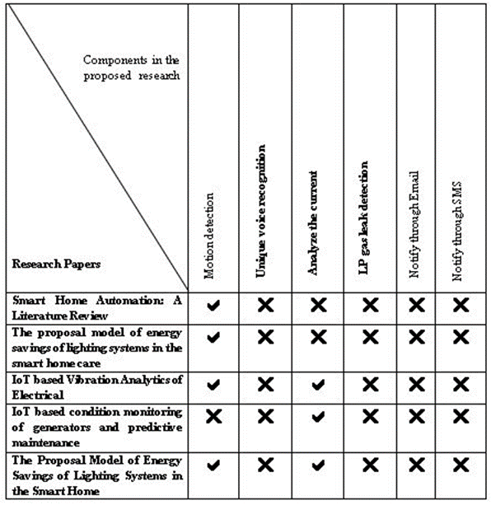
RESEARCH GAP
Kodikara R.K. IT20182182 CSNE

Slide 68
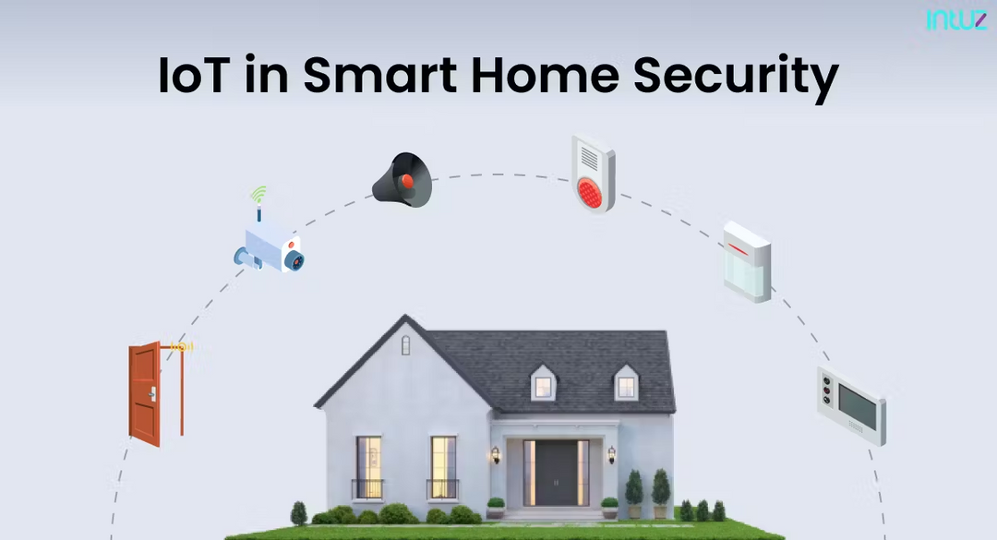
MAIN OBJECTIVE
Enable electric hazard free environment in a modern house.
Kodikara R.K. IT20182182 CSNE

Slide 69
SUB OBJECTIVES
Detect the unique voice command and turn on/off the plug base
Detect the motions and turn off the plug base if there is no motions
Detect the LP Gas and turn off the plug base
Detect the unique voice command and turn on/off the plug base
Kodikara R.K. IT20182182 CSNE

Slide 70
RESEARCH QUESTIONS
Household security and safety are increasingly important issues in the contemporary world.
The proliferation of high-tech security systems and smart homes has given people new options for keeping their homes secure.
The goal of my suggested project component is to develop an intrusion access prevention system for contemporary dwellings that is powered by machine learning.
Kodikara R.K. IT20182182 CSNE

Slide 71
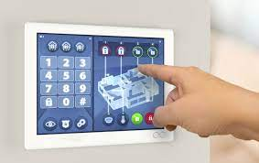
RESEARCH SOLUTION
How to turn off the plug using voice?
How to reduce electricity wastage?
How to do everyday household chores efficiently, easily and quickly?
How to protect yourself from fire in household work?
Kodikara R.K. IT20182182 CSNE

Slide 72
METHODOLOGY
Step 1 – Monitor the motions, LP Gas leak, current, and unique voice
Step 2 – Detect the if no motion, LP Gas leak and voice
Step 3 – If it’s detected turn off the plug base
Step 4 – end of the process send a SMS to the house owner
Kodikara R.K. IT20182182 CSNE

Slide 73
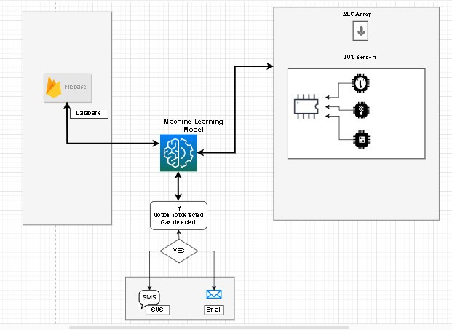
METHODOLOGY CONT.
Kodikara R.K. IT20182182 CSNE

Slide 74
FUNCTIONAL & NON-FUNCTIONAL REQUIREMENTS
Functional
Voice detection
Motion detection
LP gas detection
Monitor the Current
usage
Non-Functional
Protect household appliances
Reliable
Available
Kodikara R.K. IT20182182 CSNE

Slide 75

TECHNOLOGIES TO BE USED
Machine Learning (ML)
Internet of Things (IoT)
Python
Arduino
Kodikara R.K. IT20182182 CSNE

Slide 76
CURRENT PROJECT PROGRESS
50%
Motion detection of the module
Gas detection of the module
Voice control
Kodikara R.K. IT20182182 CSNE

Slide 77
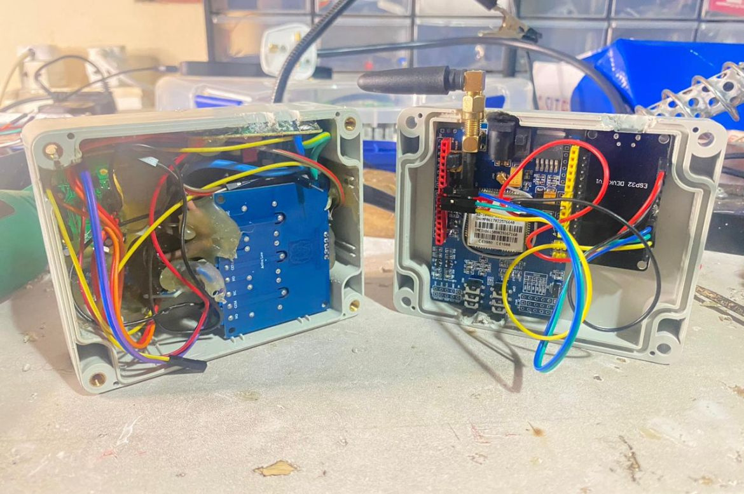
PROJECT COMPLETE SO FAR
The sensors required for this module are already taken. As shown in this image, they are attached but not assembled. Arduino code is coded to some extent.
Kodikara R.K. IT20182182 CSNE

Slide 78
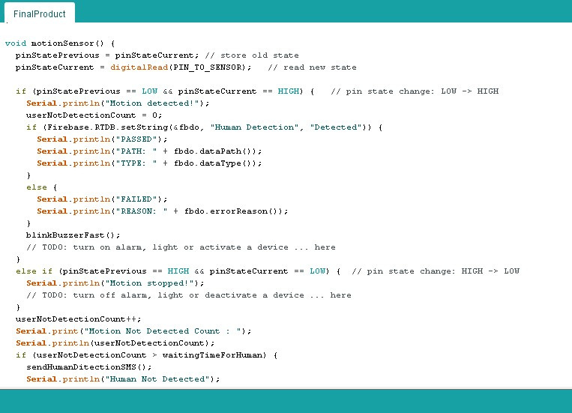
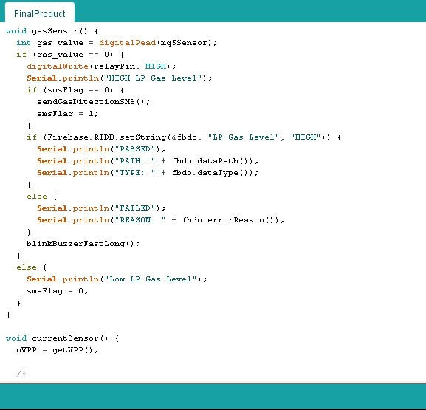
PROJECT COMPLETE SO FAR
Kodikara R.K. IT20182182 CSNE

Slide 79
FUTURE PROGRESS
Include the Current sensor and the code
Update the code
Assemble the module
Kodikara R.K. IT20182182 CSNE

Slide 80
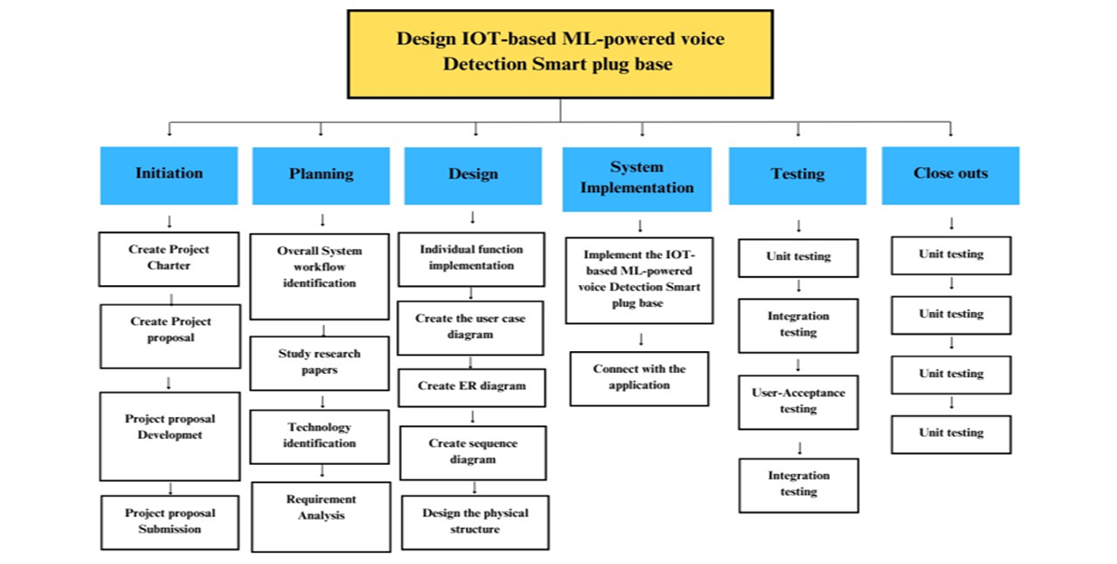
WORK BREAKDOWN STRUCTURE
Kodikara R.K. IT20182182 CSNE

Slide 81
REFERENCE
[1] P. S. Y. Vaishnavi S. Gunge, "Smart Home Automation: A Literature Review," Computer Applications, pp. 06-10, 2016.
[2] J. Vanus, T. Novak, J. Koziorek, J. Konecny, and R. Hrbac, “The proposal model of energy savings of lighting systems in the smart home care,” IFAC proc. vol., vol. 46, no. 28, pp. 411–415, 2013.
[3] Researchgate.net. [Online]. Available: https://www.researchgate.net/publication/251838675_The_development_of_smart_switch_system_for_the_automation_system_in_power_utilities. [Accessed: 18-Aug-2022].
[4] V. R. D.Ganga, "IoT based Vibration Analytics of Electrical," pp. 01-12, 2017.
[5] T. S. Gunawan et al., “Prototype design of smart home system using Internet of Things,” Indones. j. electr. eng.comput. sci., vol. 7, no. 1, p. 107, 2017.
[6] D. S. T. A. K. Md. Yaseen, "IoT based condition monitoring of generators and predictive maintenance," IEEE, Coimbatore, 2017.
[7] T. N. J. K. J. K. R. H. J. Vanus, "The Proposal Model of Energy Savings of Lighting Systems in the Smart Home," Department of Cybernetics andBiomedical Engineering, VSB TU Ostrava, elkeKarlovice, Czech Republic, 2013.
Kodikara R.K. IT20182182 CSNE

Slide 82
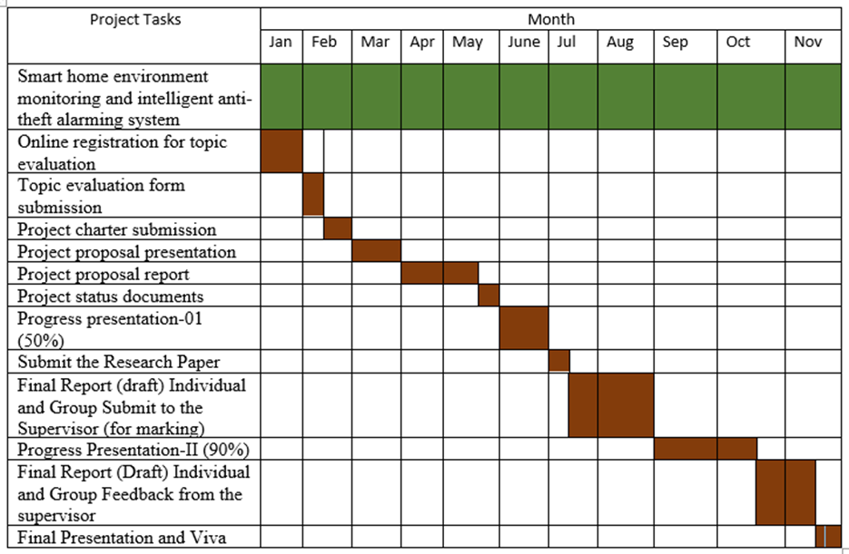
PROJECT PROGRESS COMPLETION

Slide 83
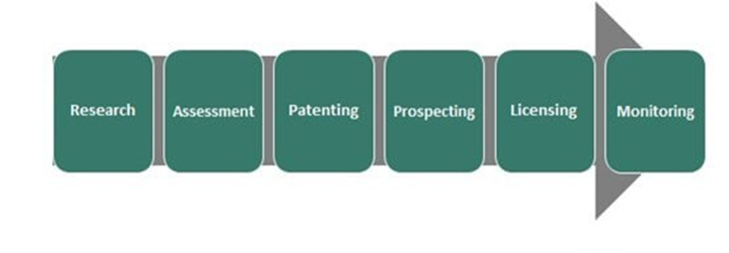
COMMERCIALIZATION

Slide 84
THANK YOU!

